Slide 1
Bubble Sort
Bajwa, Qaasid CSC 21000
12/2/24

Slide 2
Introduction
What is Bubble Sort?
A simple comparison-based sorting algorithm.
Time complexity: O(n^2)
Suitable for Small Datasets
HW Aims:
Implement Bubble Sort in C++
Optimize compiler generated code for better performance
Measure runtime

Slide 3
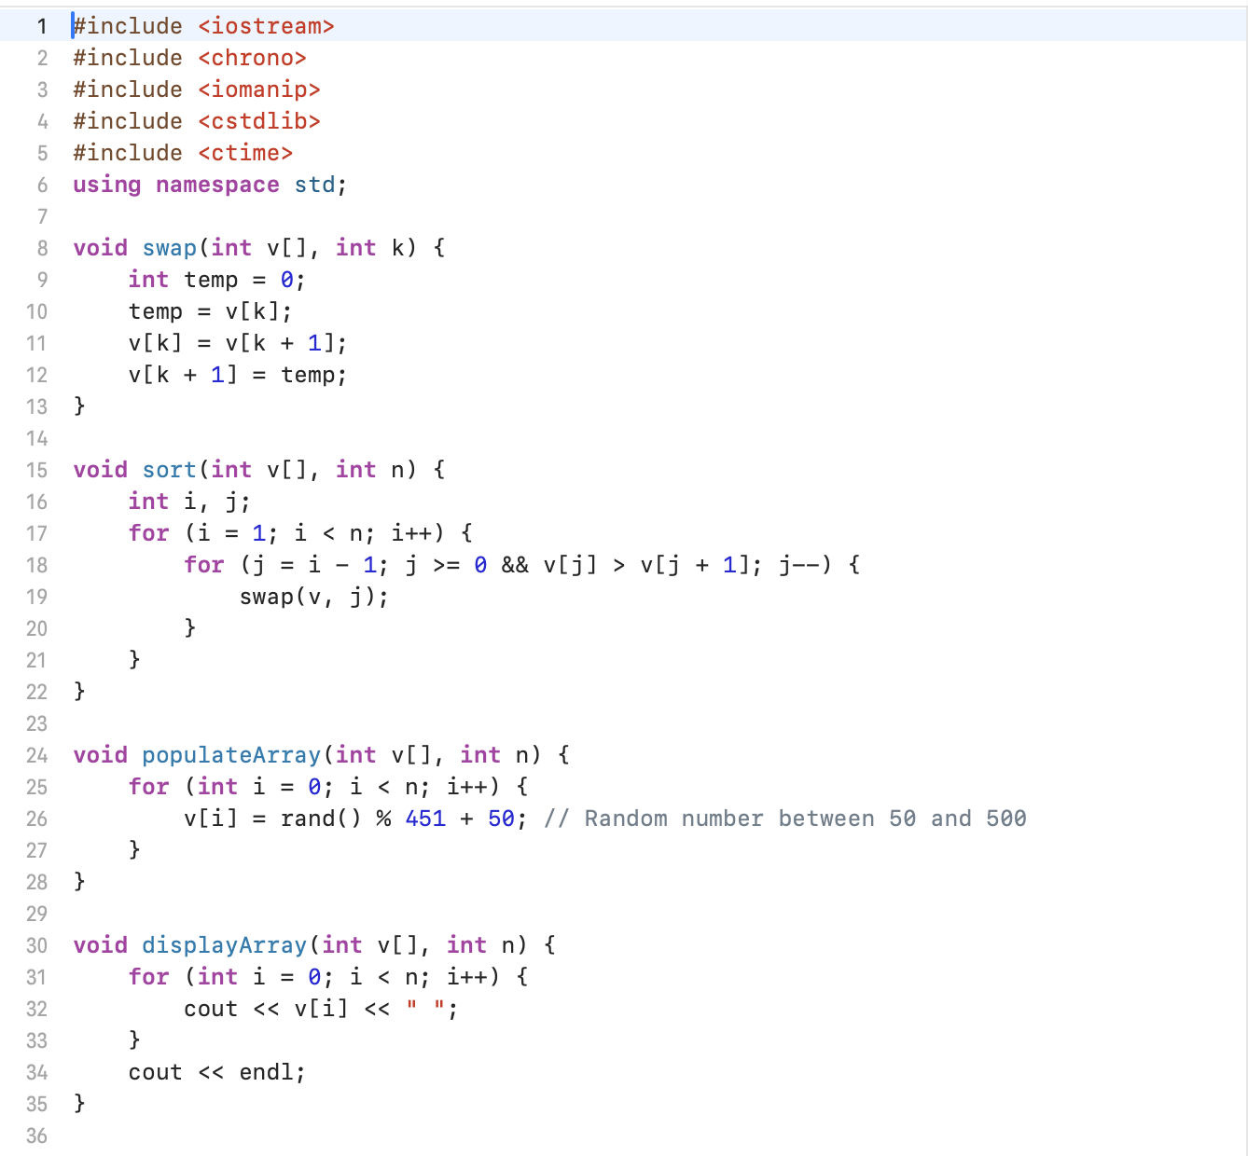
C++ Code

Slide 4
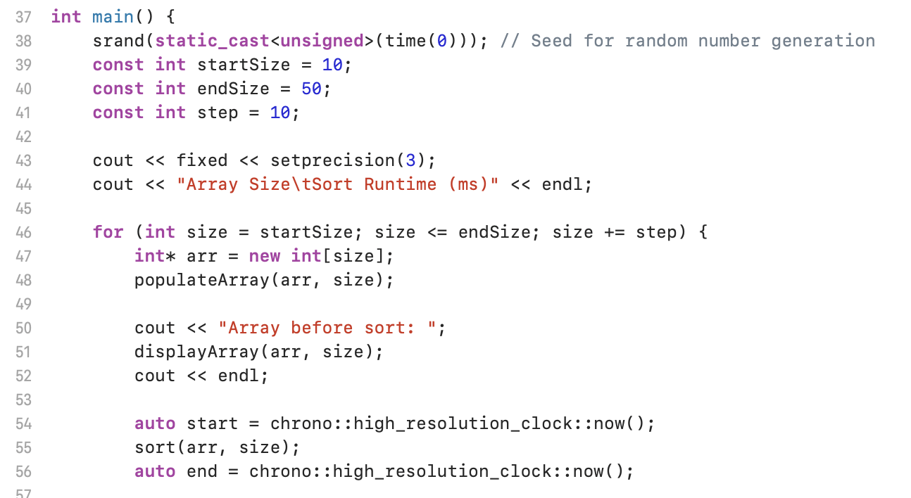
C++ Code (cont.)

Slide 5
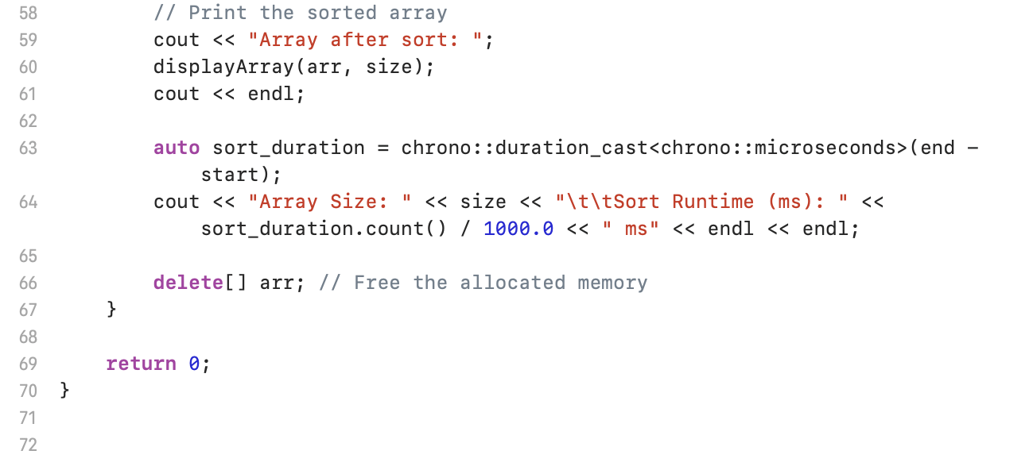
C++ Code (cont.)

Slide 6
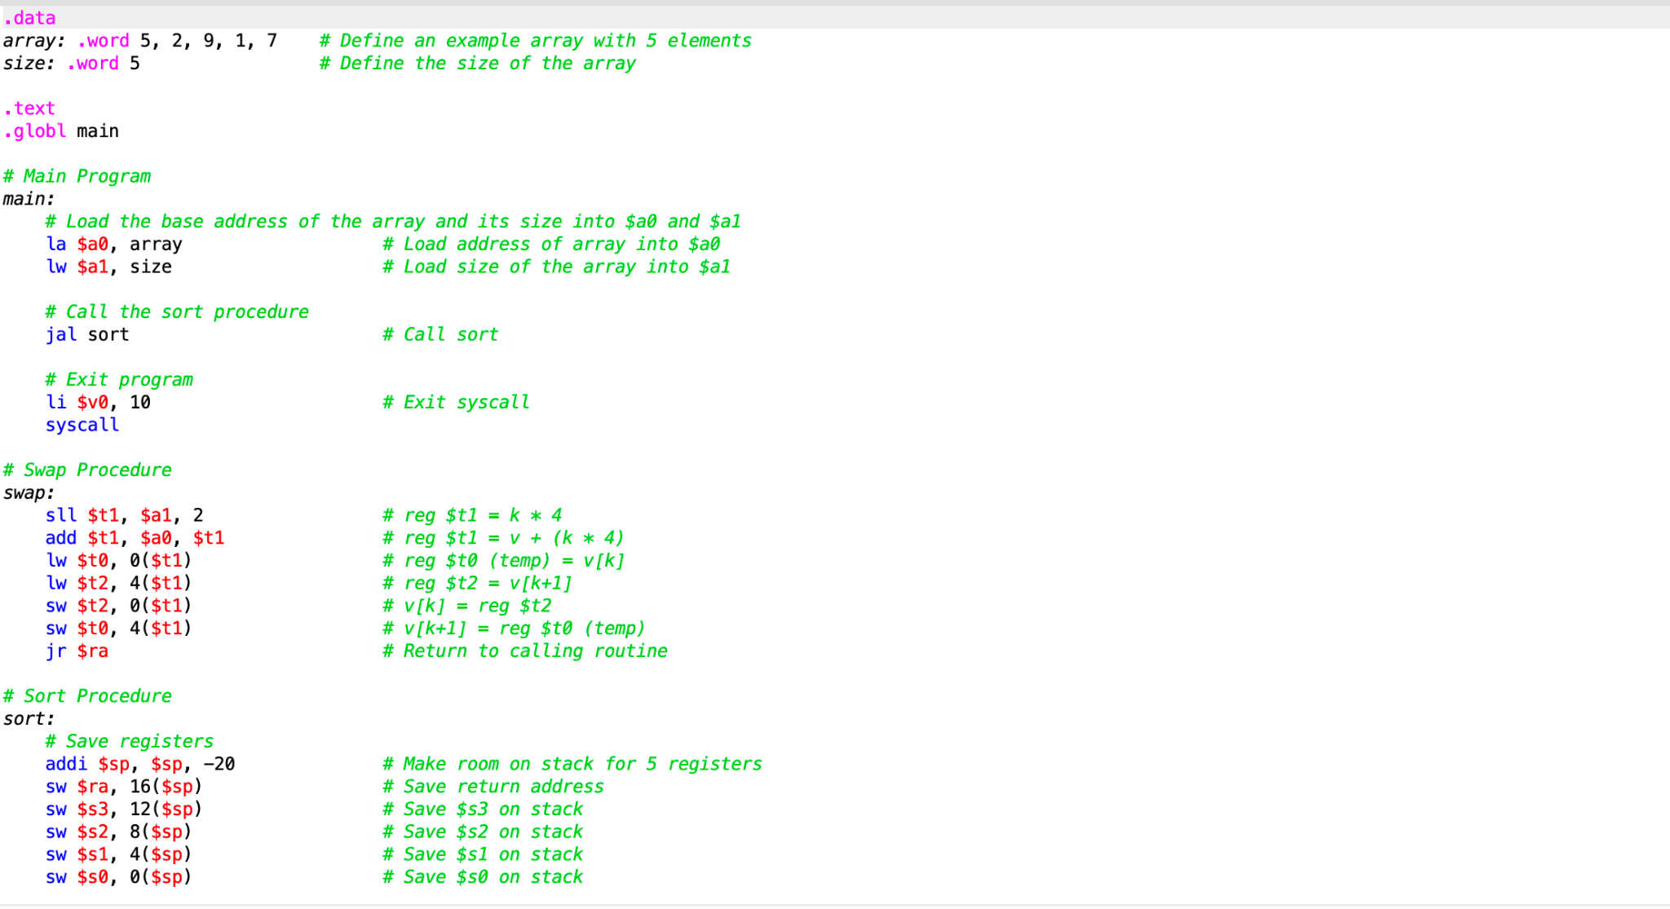
MIPS Code

Slide 7
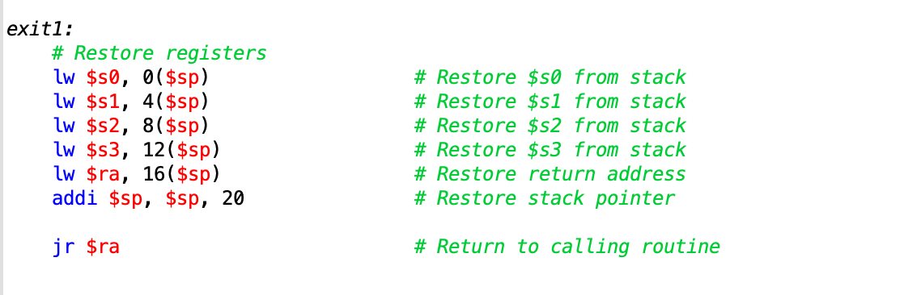
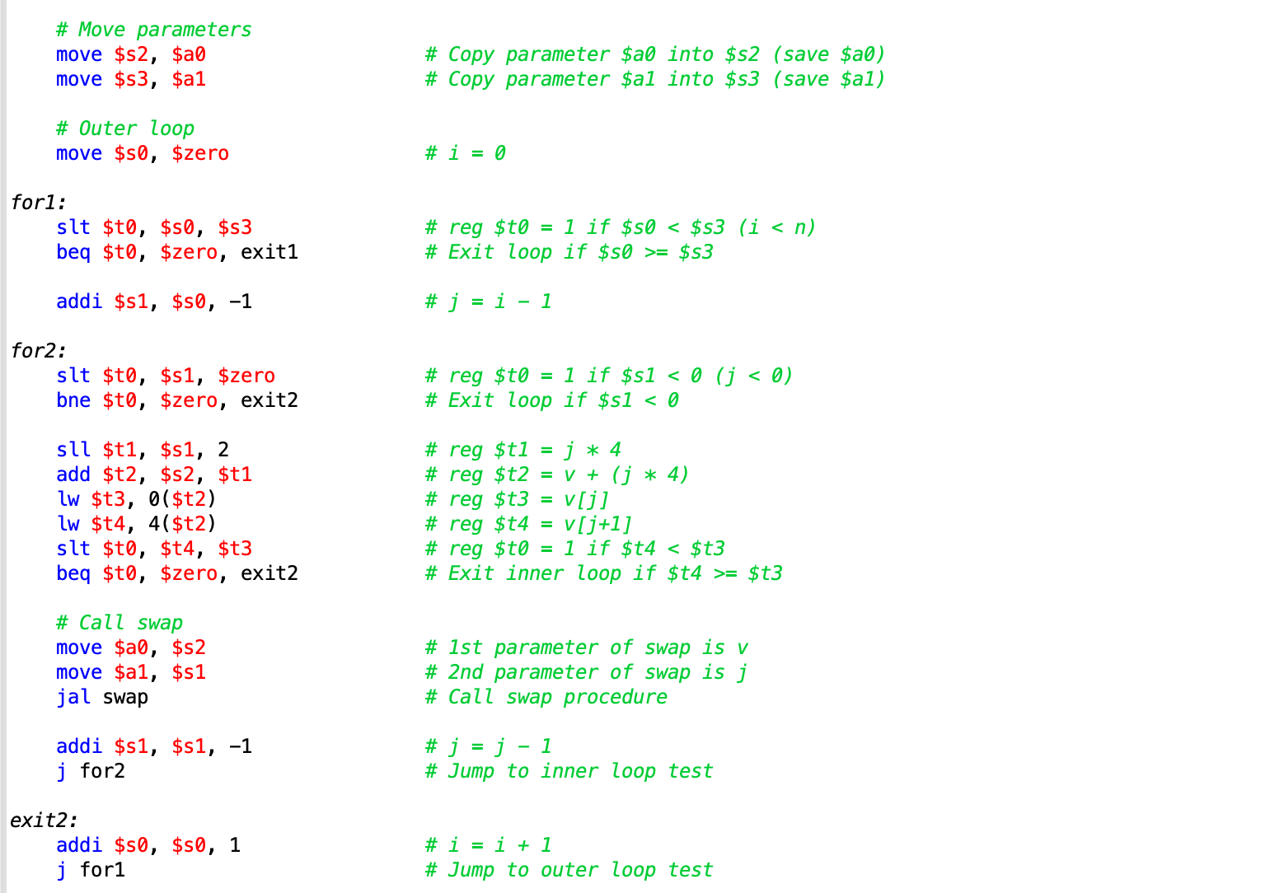
MIPS Code (cont.)

Slide 8
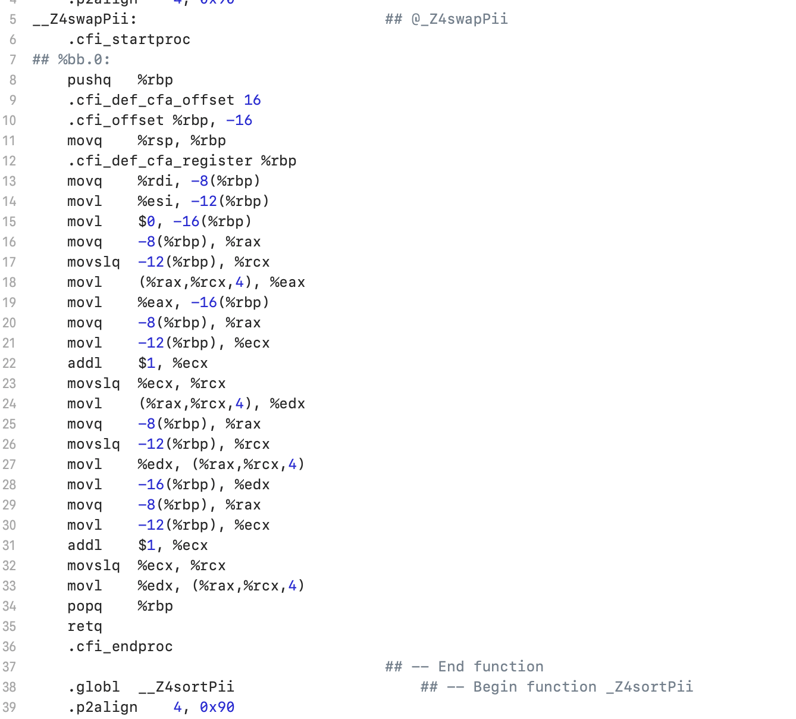
Compiler Code (swap function unoptimized)

Slide 9
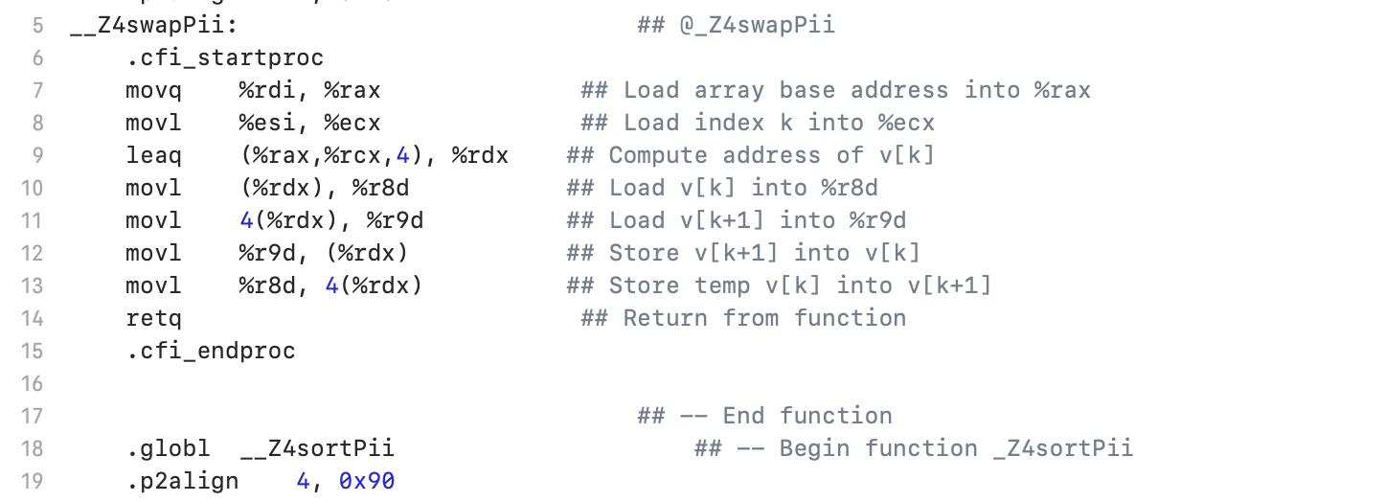
Compiler Code (swap function optimized)

Slide 10
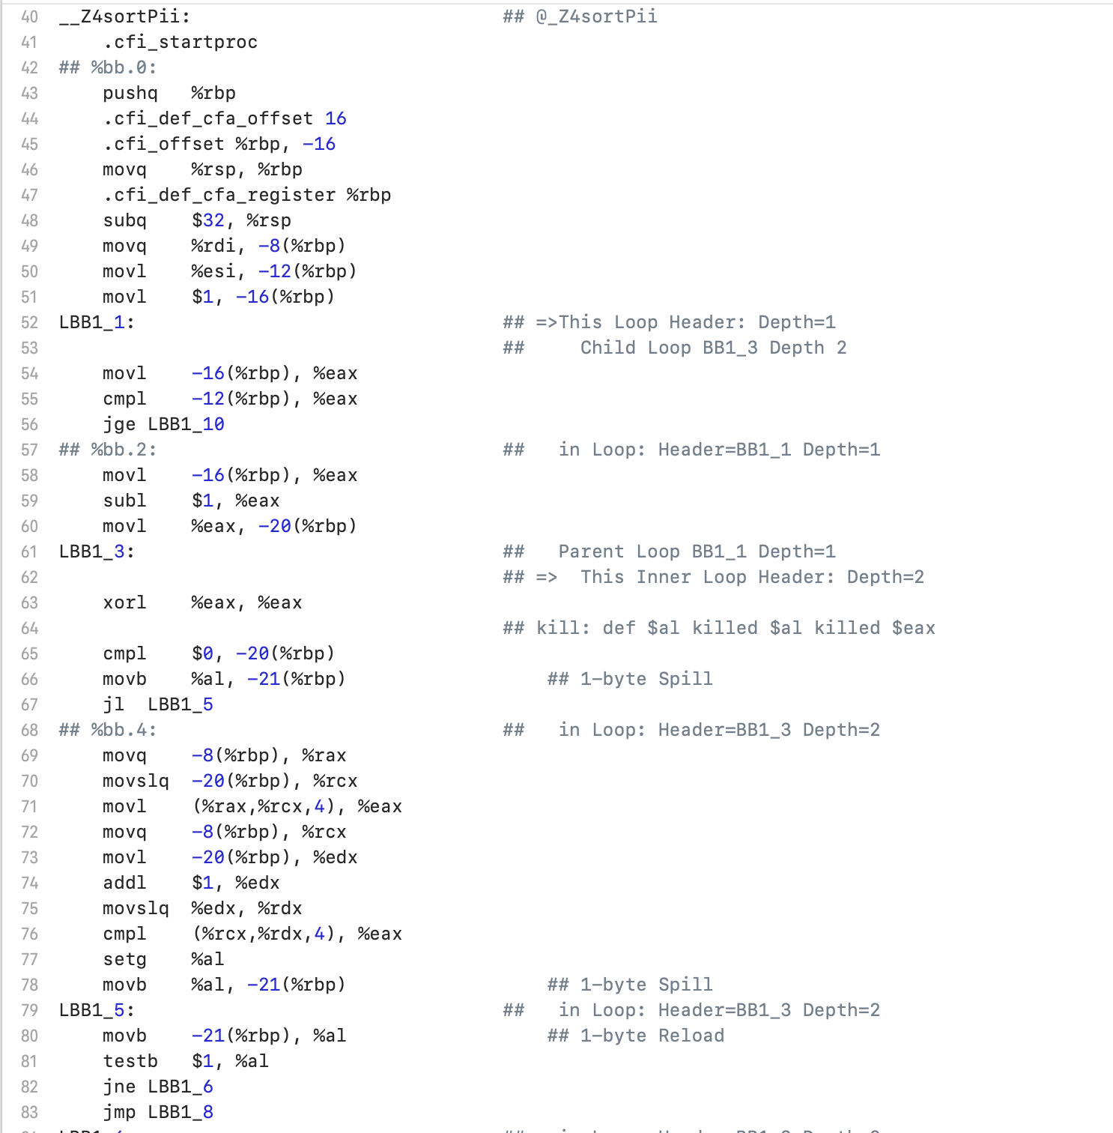
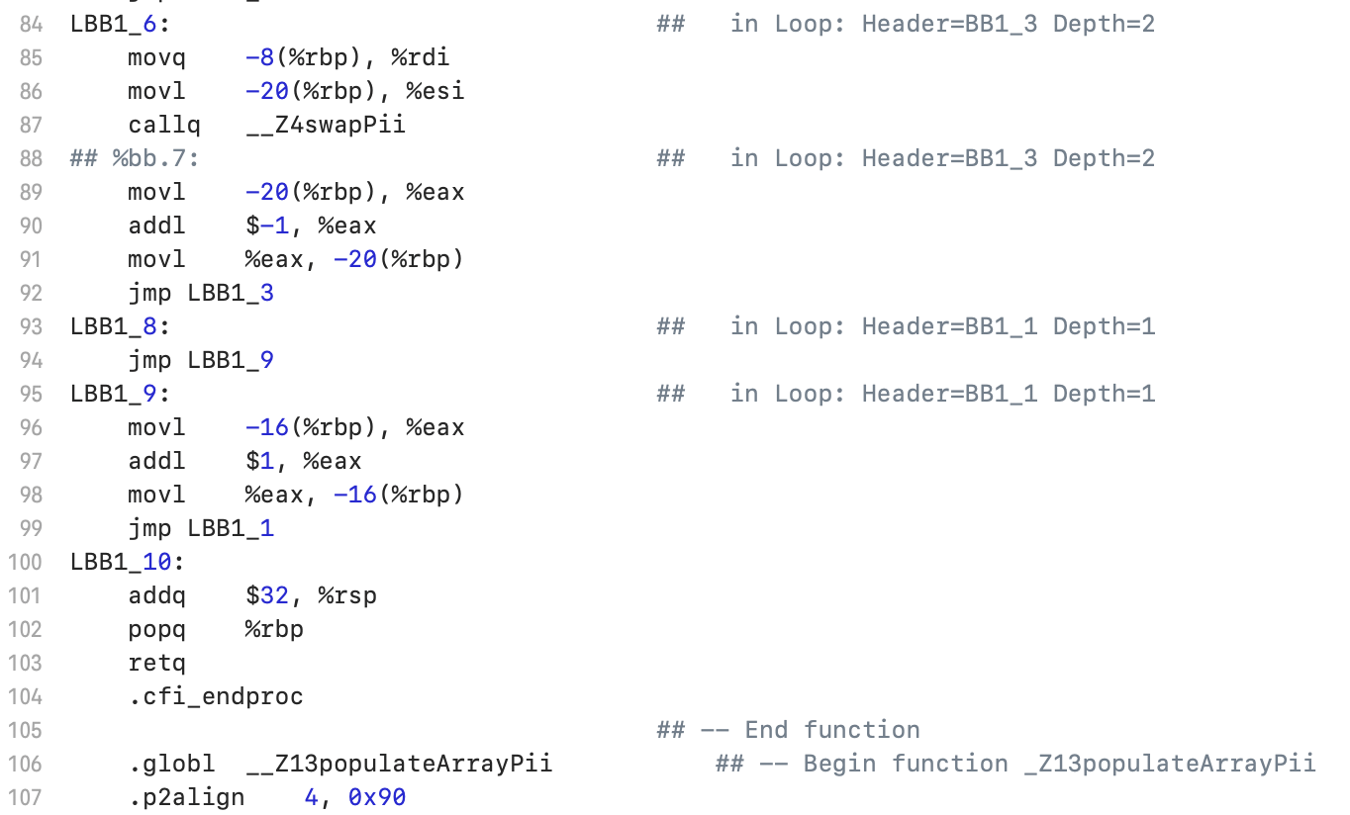
Compiler Code (Sort function)

Slide 11
Optimizations
No stack usage. All operations are performed using registers (%r8d, %r9d), eliminating the need for stack space. This avoids the subq $32, %rsp and popq %rbp instructions entirely.
Efficient address calculation. It computes the memory address of v[k] directly using leaq (%rax,%rcx,4), %rdx # Compute address of v[k]. This avoids explicit index increments (addl $1, %ecx) and repeated base address calculations.

Slide 12
Optimizations (cont.)
Reduced memory access. Instead of loading and storing values multiple times, each array element is accessed only once:
movl (%rdx), %r8d # Load v[k] into %r8d
movl 4(%rdx), %r9d # Load v[k+1] into %r9d
These values are swapped directly in registers and stored back to memory:
movl %r9d, (%rdx) # Store v[k+1] into v[k]
movl %r8d, 4(%rdx) # Store v[k] into v[k+1]
Shorter Instruction Sequence (8 to 26)

Slide 13
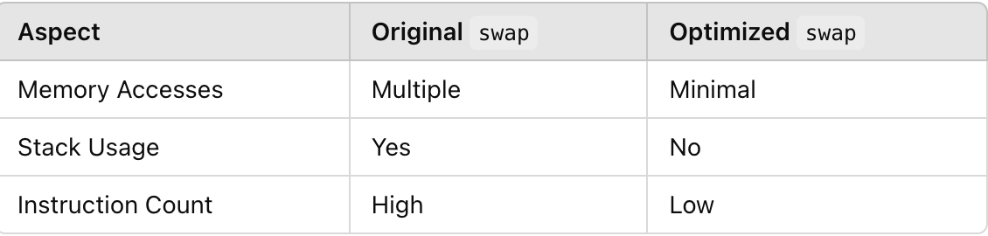
Optimizations (cont.)

Slide 14
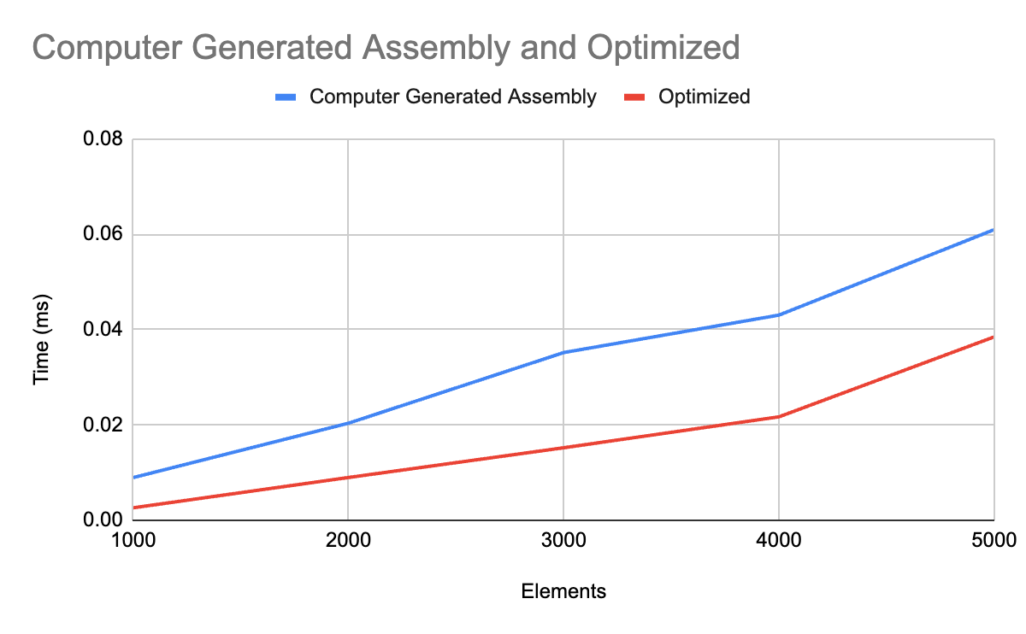
Results
Optimization works!

Slide 15
The End
Thank You!

